Slide 1
Language & Tooling
Aden Earnshaw

Slide 2
Language & Tooling
C# 11 New Features
User Tokens
Tunnelling
Support

Slide 3

Required members
Apply `required` keyword on Fields or Properties
Enforces assignment of properties during initialization
Improves nullable experience
Allows library authors ability to demonstrate how their code should be implemented easier
Notes:
5:12

Slide 4
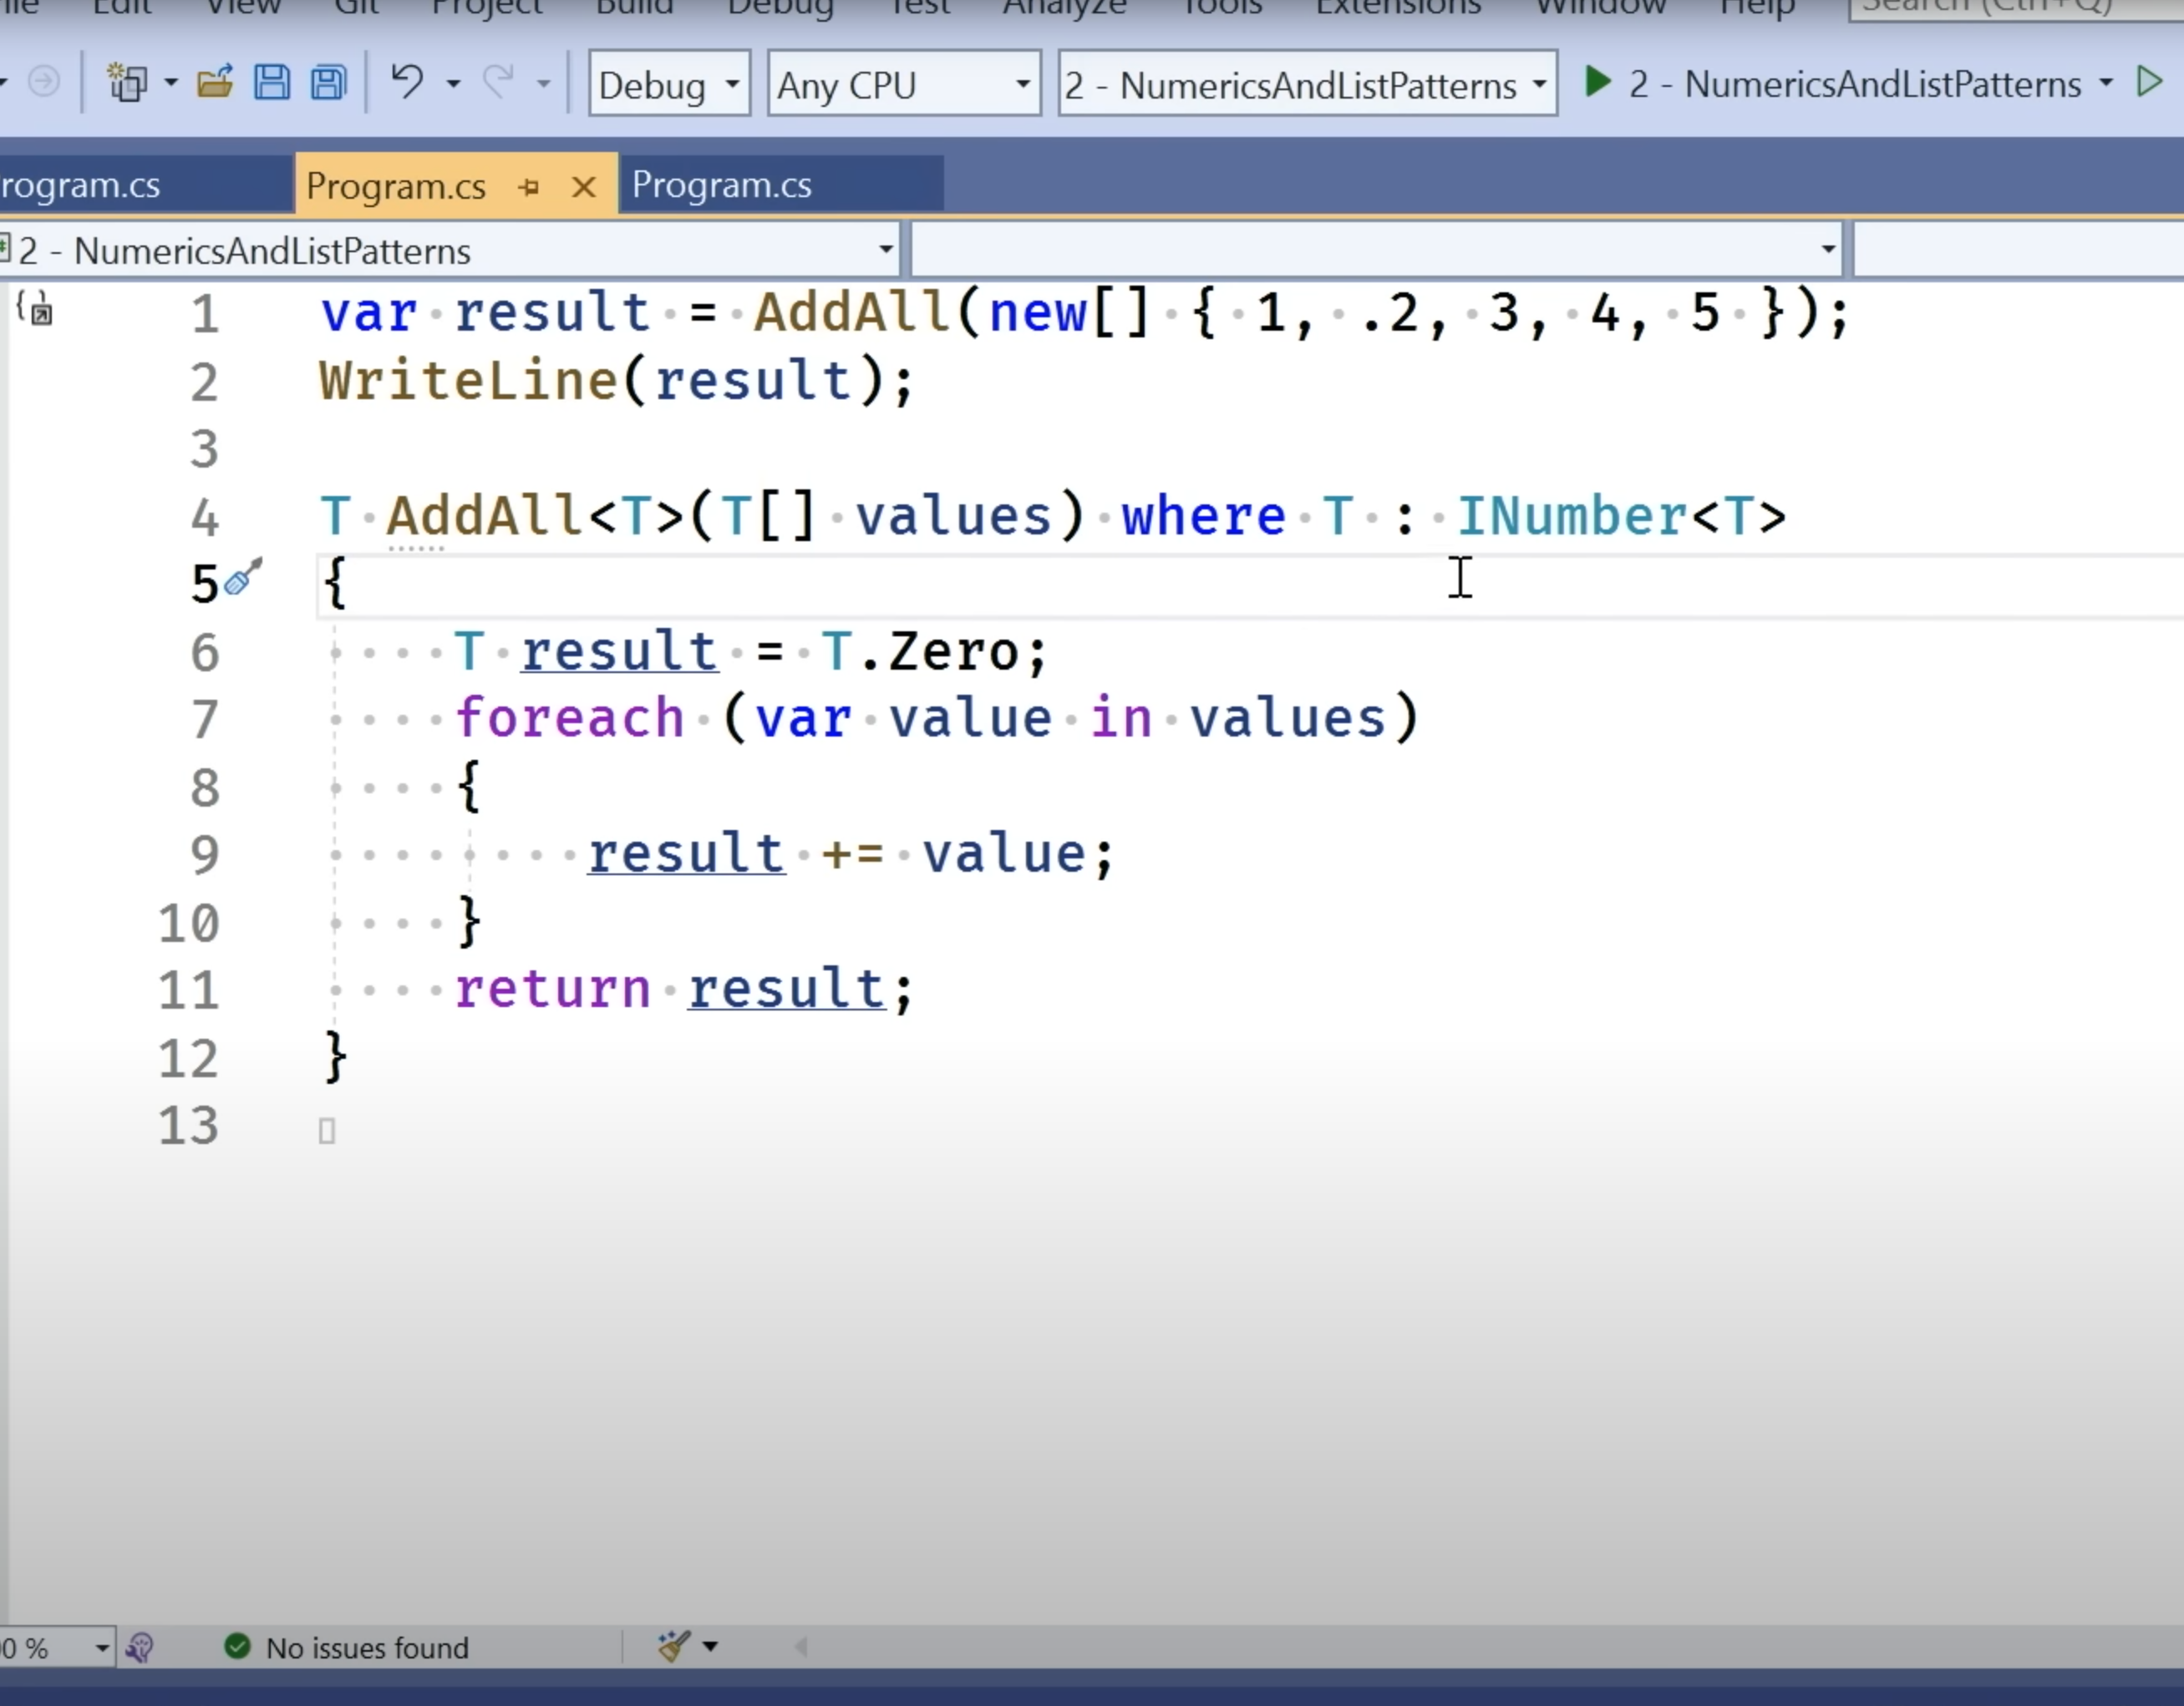
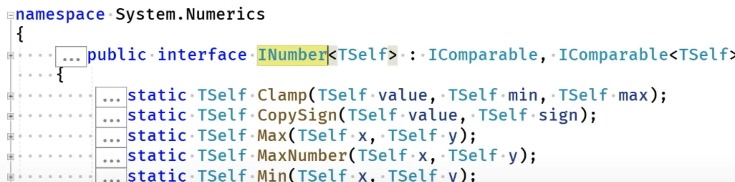
Static Abstract & Virtual Interface Methods
Enforce inherited classes to implement static methods
Provide default implementations of Static Members via Interface
Generics can implement logic and take advantage of static methods & properties
Allows Factories to specify signature create methods for concrete implementations
Notes:
INumber.cs (dot.net)

Slide 5
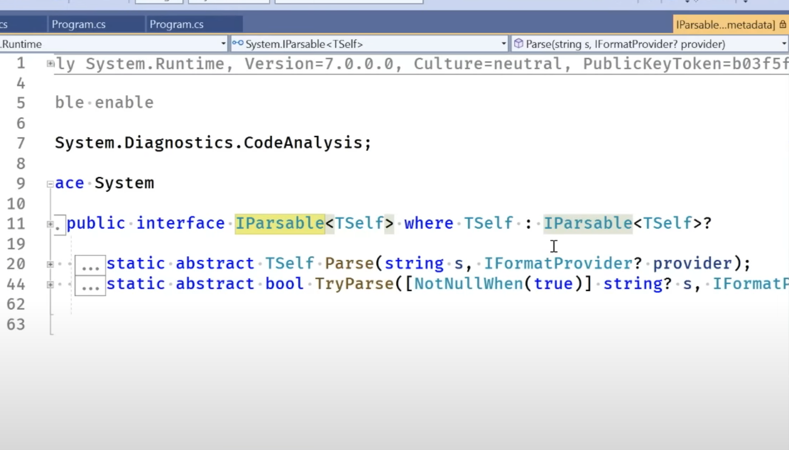
Notes:
IParsable.cs (dot.net)

Slide 6
List Patterns
Extends pattern matching to inspect List or Array sequences
Allows deconstruction of arrays using the `is` keyword
Notes:
4:39

Slide 7
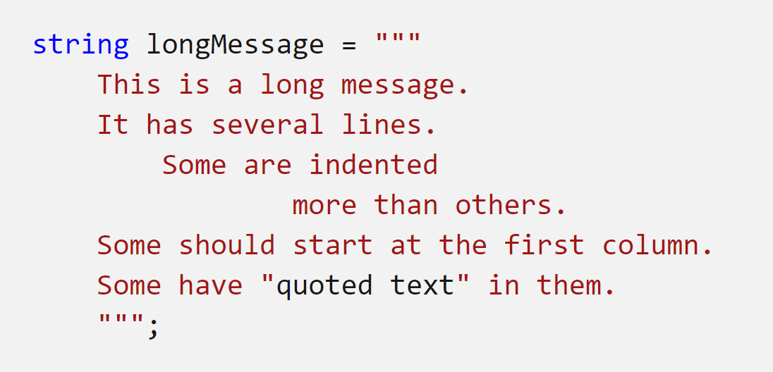
Raw String Literals
Declare strings with text, whitespace, new lines, embedded quotes and other characters without escape sequences
Start with at least 3 double-quotes (“””)
Leading whitespace ignored
Supports string interpolation

Slide 8
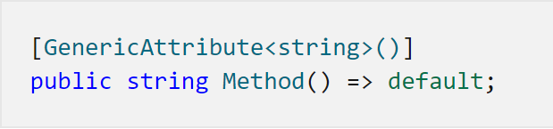
Generic Attributes
More convenient syntax for attributes that require a type parameter
Type cannot be passed from parent class and must be a fully constructed type
`nameof` expression can be used in Attribute declarations

Slide 9
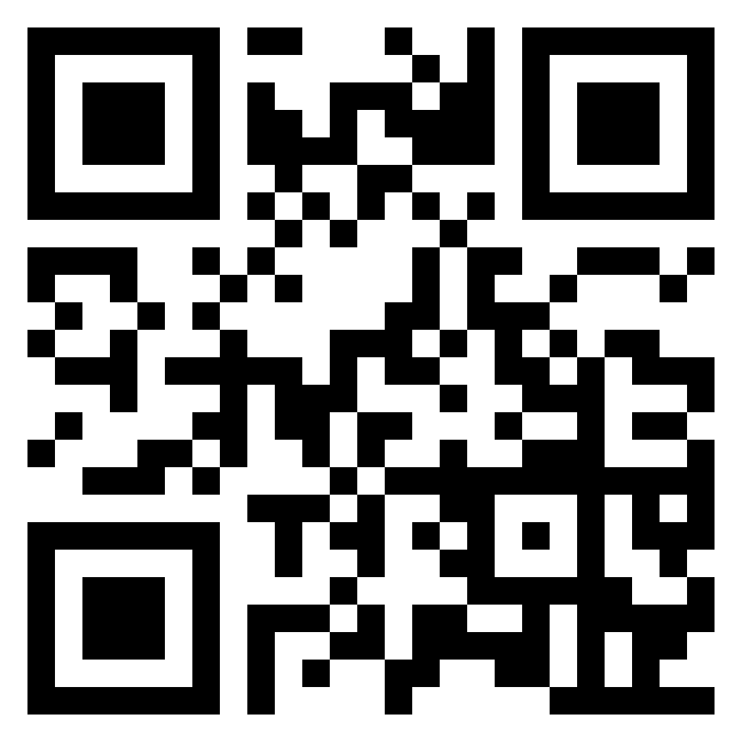
C# 11 Features
Required Members
Static Virtual and Abstract interface methods
List Patterns
Raw String Literals
Generic Attributes
File-scoped types
Auto-default structs
Pattern match Span<char> on const string
Extended nameof scope
Numeric IntPtr
UTF-8 string literals
Ref fields and scoped ref
Newlines in string interpolation
bit.ly/csharp-11

Slide 10
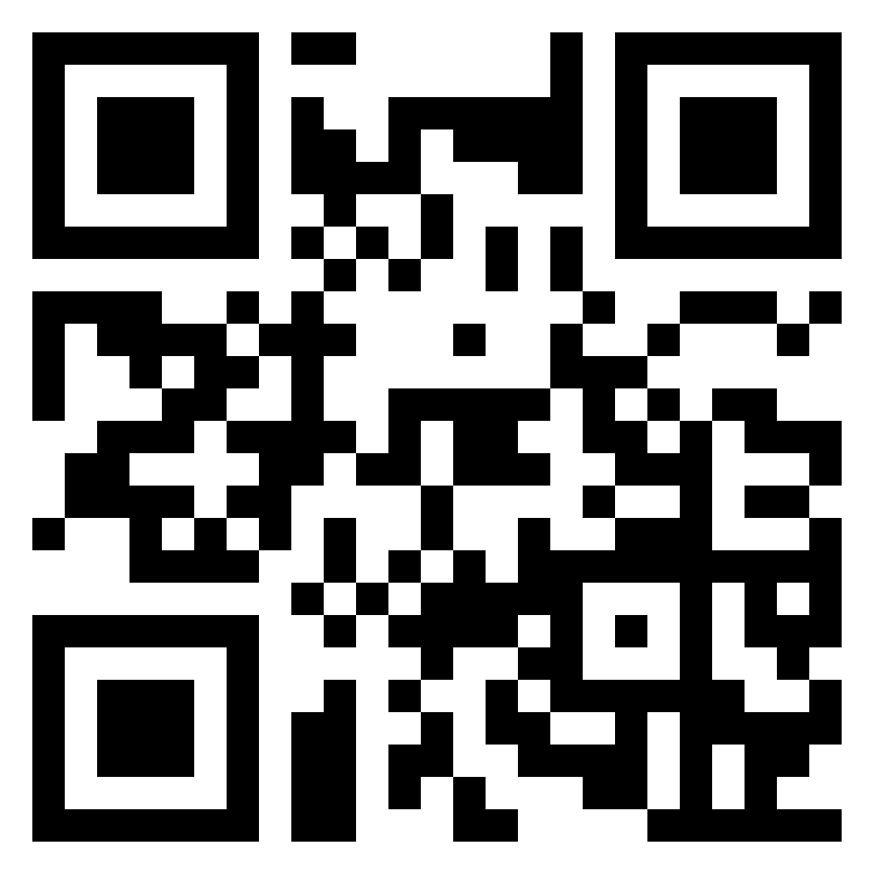
User Tokens
`dotnet user-jwts`
Customise scheme, name, audience, issuer, scopes, roles, claims & expiration
Bypass auth calls to Identity Provider
Jwks?
bit.ly/user-jwts
Notes:
3:44

Slide 11
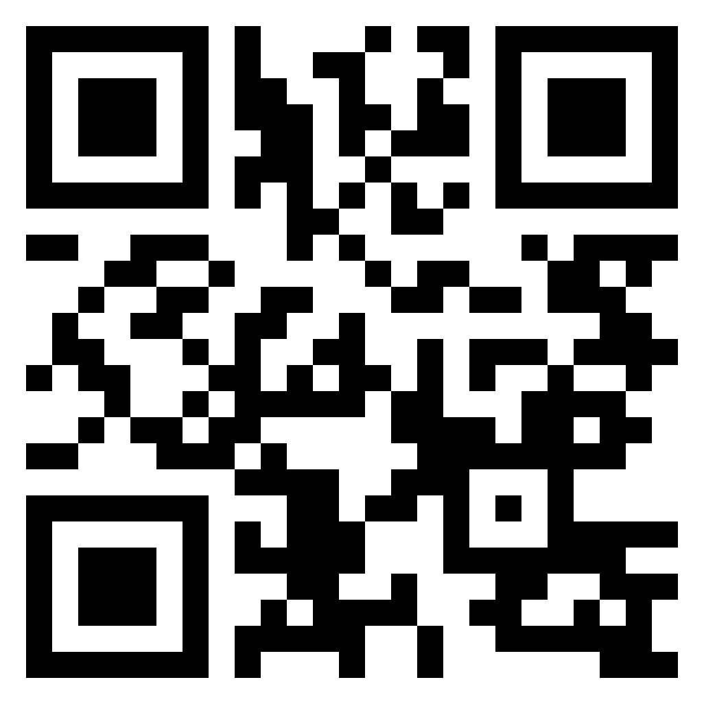
Dev Tunnels
Port forward locally running apis
Individual, Organisation or Public access
Visual Studio 2022 17.4 required
bit.ly/dev-tunnels
Notes:
2:14

Slide 12
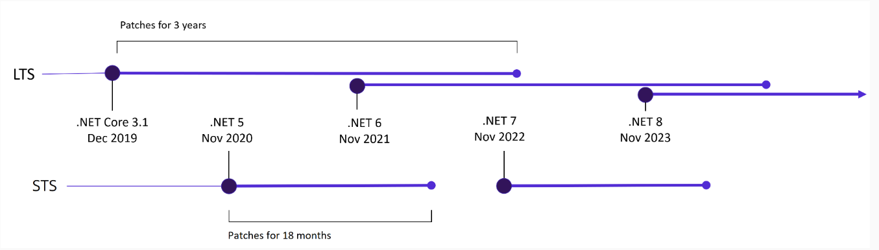
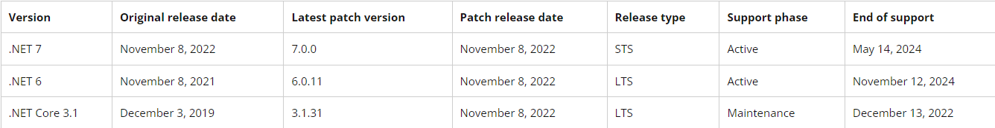
.NET 7 Support

